Slide 1


Property Chain
Siddharth Sharma

Slide 2
Contents
Problems
Challenges in the current land registration process.
Why blockchain land registry platform a right solution?
Georgia’s blockchain land registry project.
How could blockchain land registry platform work?
Business Benefits.

Slide 3
Problems
Land Registry is one of the use cases that involve a lot of intermediaries to put trust in the system.
Keeping track of who owns which pieces of land or property is difficult when you have hundreds or even thousands of years of land records
It’s common to encounter discrepancies within the paperwork, including forged documents, counterfeit titles and, even a complete loss of all documentation.

Slide 4
Some facts:
Worldwide, these land registry-related problems are estimated to be worth $20 trillion.
According to Transparency International, 20 percent of land service users worldwide admitted that they have paid a bribe in order to register their property or verify land ownership information.
Distortion created by large-scale corruption and inefficiency in India’s land markets has shaved 1.3% off the country’s GDP every year
According to Worldbank, on average, it takes 58 days to register property in India, 52 in Germany, 15 in USA.

Slide 5
Challenges in the existing land registry process:
Land records are stored in a centralized database with no additional benefits other than being a paper registry
The involvement of middlemen/brokers
The increasing number of fraud cases
Time Delays
Human error/intervention

Slide 6
Can blockchain overcome these challenges in the existing land registry system?
Yes, It can

Slide 7
Why Blockchain Land Registry Platform is a right solution?
Can Remove the middlemen and third party verification
Can Reduce frauds/forgery
Can Bring transparency
Can Automate and Fasten up the process

Slide 8
Countries planning to introduce blockchain in land registry system
USA
Netherlands
UK
Sweden
even INDIA.

Slide 9
Georgia’s blockchain land registry project
According to Forbes, the Georgia pilot project marks the first time a national government used the Bitcoin Blockchain to record land titles.
As of 2018, a total of 1.5 million land titles in the Republic of Georgia were published on the Blockchain, which ensures the security and immutability of the data.

Slide 10
Georgia’s blockchain land registry project
By using blockchain technologies, Georgia’s National Agency of Public Registry (NAPR) can provide its citizens with a digital certificate of their assets, supported with cryptographical proof published to the blockchain.
All the registrations are made on a private ledger
They are verified through the Bitcoin blockchain
The project will continue to advance, ultimately using smart-contract capabilities to streamline business operations for NAPR, including the sale of property, transfer of ownership and more.

Slide 11
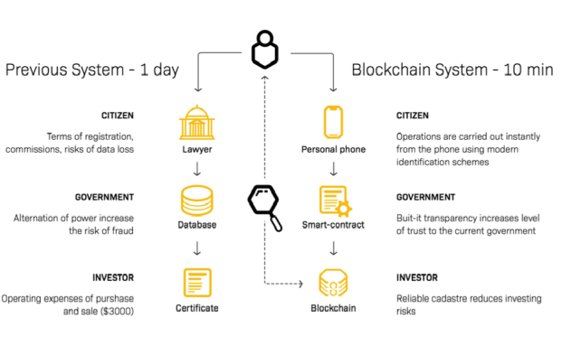

Slide 12
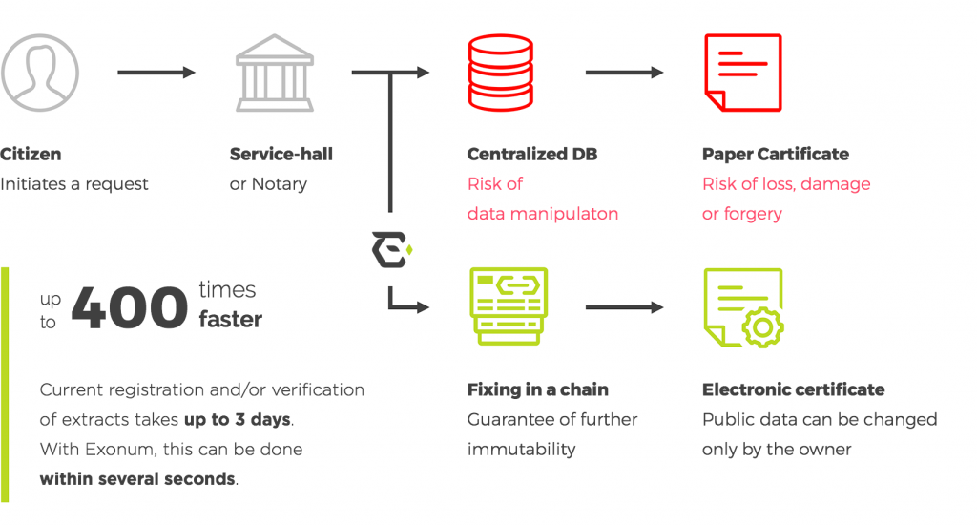

Slide 13
How could Blockchain Land Registry Platform work?

Slide 14
Possible Steps
Step 1: Users register to the platform
Step 2: Sellers upload the property specifications on the platform
Step 3: Buyers request access to the listed property

Slide 15
Step 4: Sellers approve the transfer request and land inspector gets the notification.
Smart contracts trigger to provide land documents’ access to the land inspector.
After the land inspector verifies the documents, they schedule the meeting for ownership transfer with buyer and seller.
The meeting record is also added to the blockchain to solve property related disputes if occur in the future.

Slide 16
Step 5: Land Inspector verifies the transaction and initiates the transfer
Sellers and buyers sign the property ownership transfer document in front of the land inspector on the land registry platform.
The signed document gets saved in the database and transaction corresponding to it is recorded on the blockchain.
The transfer is initiated and smart contracts trigger to send funds to the seller and title’s ownership to a new buyer.

Slide 17
Land registry document validation and authenticity
In case of any disputes, any authorized party can upload the signed land registry document on the platform to check its authenticity and validate it.
If hash generated after uploading the document is the same as that of the hash created at the time of signing the document, then the document is authenticated and no modifications have been made to the document.

Slide 18
Near real-time visibility into status of property and sale deed with access to complete and permanent transaction history
Average time taken to process land transactions reduces significantly
Reduction in administrative costs by eliminating manual processes
Eliminates the need to store physical archives of land records
Enhanced data security and authenticity of land records renews confidence of buyers in the land registry system
Increase in land investments
Business Benefits

Slide 19
References
1.https://modex.tech/using-blockchain-to-reshape-land-registry-and-property-rent/
2.https://www.coindesk.com/blockchain-land-registry-solution-seeking-problem
3.https://www.mitpressjournals.org/doi/pdf/10.1162/inov_a_00276
4.https://www.undp.org/content/undp/en/home/blog/2018/Using-blockchain-to-make-land-registry-more-reliable-in-India.html
5.https://www.qburst.com/resources/case-studies/blockchain-land-registry/
6.https://qz.com/india/1325423/indias-andhra-state-is-using-blockchain-to-build-capital-amaravati/
7.https://niti.gov.in/sites/default/files/2020-01/Blockchain_The_India_Strategy_Part_I.pdf

Slide 20

Thank You!

